Slide 1


Introduction to Logstash
Mr. Iyanou Eraste AKANDE Elastic Certified Engineer Data Engineer at Synaptique Maghreb

Slide 2

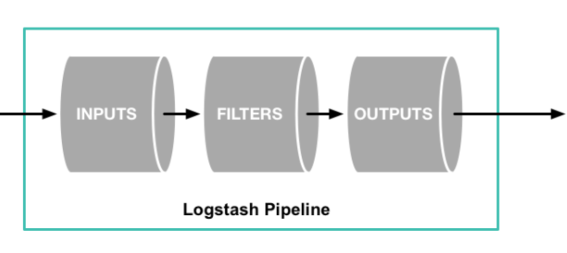
Configuration
Architecture

Slide 3
Configuration
Sample file
# Sample Logstash configuration for creating a simple
# Beats -> Logstash -> Elasticsearch pipeline.
input {
beats { port => 5044 }
}
filter {}
output {
elasticsearch {
hosts => ["http://localhost:9200"]
index => "filebeat-%{+YYYY.MM.dd}"
user => "elastic"
password => "changeme"
}
}

Slide 4
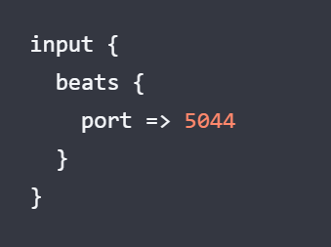
Configuration
Input
https://www.elastic.co/guide/en/logstash/current/input-plugins.html

Slide 5
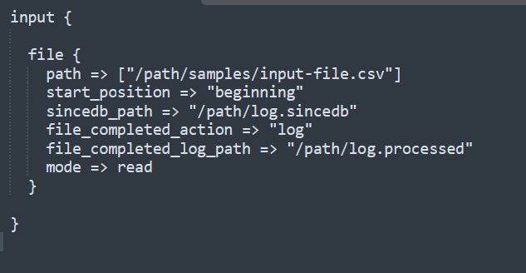
Configuration
Input
https://www.elastic.co/guide/en/logstash/current/input-plugins.html

Slide 6
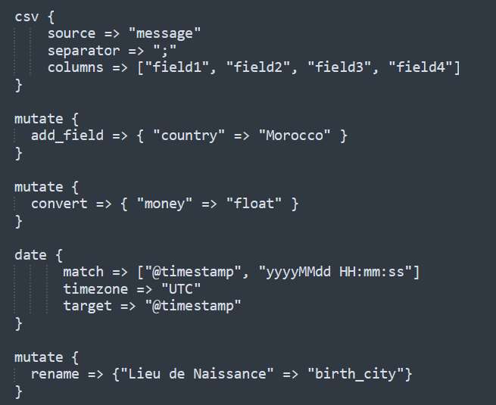
Configuration
Filter
https://www.elastic.co/guide/en/logstash/current/filter-plugins.html

Slide 7
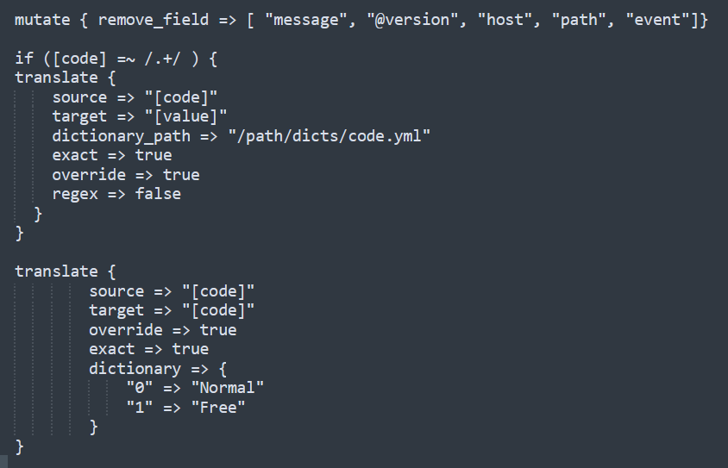
Configuration
Filter
https://www.elastic.co/guide/en/logstash/current/filter-plugins.html

Slide 8
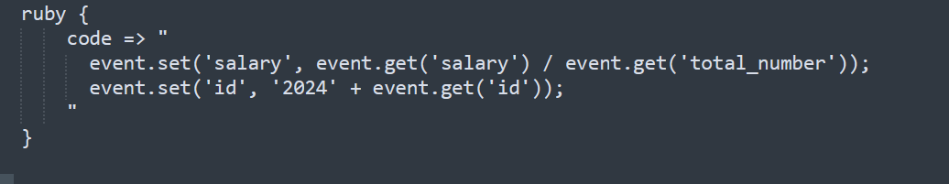
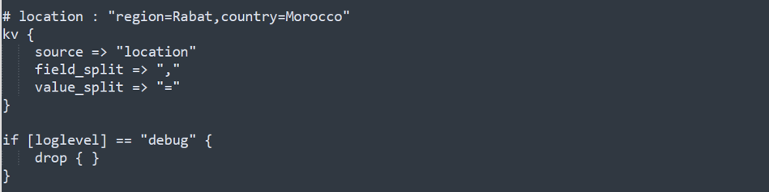
Configuration
Filter
https://www.elastic.co/guide/en/logstash/current/filter-plugins.html

Slide 9
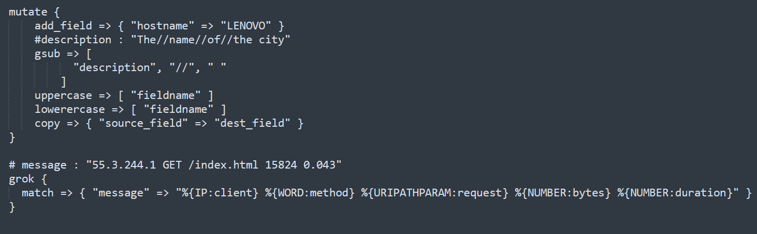
Configuration
Filter
https://www.elastic.co/guide/en/logstash/current/filter-plugins.html

Slide 10
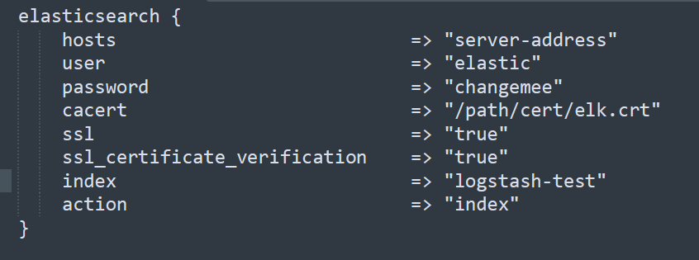
Configuration
Output
https://www.elastic.co/guide/en/logstash/current/output-plugins.html

Slide 11
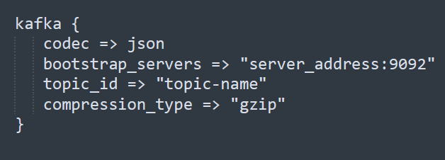
Configuration
Output
https://www.elastic.co/guide/en/logstash/current/output-plugins.html

Slide 12

Questions

Slide 13
Thank you
Mr. Iyanou Eraste AKANDE
eraste.akande@gmail.com

